Slide 1

Birth of Computer Programming
Dr. Owais Hussain

Slide 2
Sample 2
INTRODUCTION
44
Github repos
6
FYP/MS Thesis supervised
10
Publications
150+
Citations
20
Medium to large-scale projects completed
3
Affiliations
6
Countries travelled to
16
Years in Software Industry

Slide 3
Sample 2
Introduction
Alan Turing, the person who led the team that cracked the (in)famous Enigma code.
Turing was the first one who conceptualized “Turing Machine”.
Or did he???
Notes:
During World War II, the Allies' successful decryption of the German Enigma machine's encoded messages was a critical factor in their victory. The decryption effort, led by British mathematician Alan Turing, involved the use of sophisticated data structures and algorithms to crack the Enigma codes. By extracting vital intelligence from intercepted communications, the Allies gained a significant advantage in strategic decision-making, enabling them to thwart German military operations.

Slide 4
Sample 2
Origins of Computer Programming
Father of algorithms and inventor of variables, Al-Khwarizmi introduced algorithms to the western world in 9th century.
Persian and Arab Mathematicians kept developing algorithms for arithmetic operations for all practical purposes.
John Napier (1617) invented logarithms, which simplified calculations.
Leibniz (1670s) developed the binary number system.
George Boole introduced Boolean algebra in 1850s.
All of the works so far were to solve existing practical problems.
But then came the mother of programming…
Notes:
The word "algorithm" is derived from Al-Khwarizmi’s name.

Slide 5
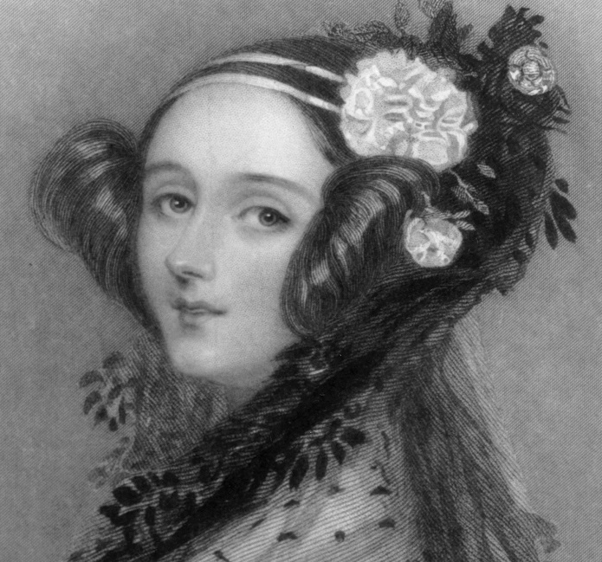
Sample 2
Story of Ada Augusta Lovelace
The first thing you need to program a computer, is a computer. Right?
Augusta Ada Lovelace didn’t need one to conceptualize “flyology”.
She wrote programs for the analytical engine to Add, subtract, multiply, divide, and even calculate Bernoulli numbers.
Notes:
Ada Lovelace, born to Lord Byron, the poet in 1815. Byron was a lowlife drunk man with low morals but wrote beautiful romantic poetry which inspired Ada.
The other traits came from her mother, a strictly religious mathematician. Ada learned algebra, geometry, physics, history, languages, geography, music, sewing, riding, shorthand, dance and more.
Flyology: a flying machine that could flap its wings.
Ada was bedridden for the most part of her teenage due to sicknesses. At the age of 18, she recovered and met Charles Babbage, the father of computer. She impressed him by demystifying his steam-based multiplication machine.

Slide 6
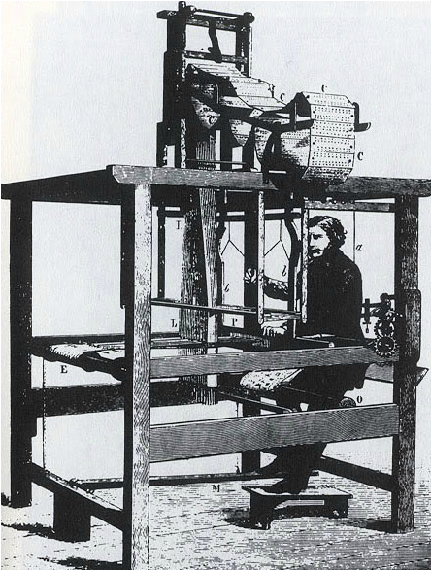
Sample 2
From Abacus to Analytical Engine
So, what exactly was Augusta Ada’s contribution?
Joseph-Marie Jacquard invented “Jacquard Loom”.
Charles Babbage picked up on this idea and imagined a loom which could be programmed.
By this time, he had already invented the difference engine.
Notes:
Jacquard loom itself wasn’t a whole loom but an attachment which could punch patterns on cards. The original idea was to produce patterns on fabric which was being weaved on loom

Slide 7
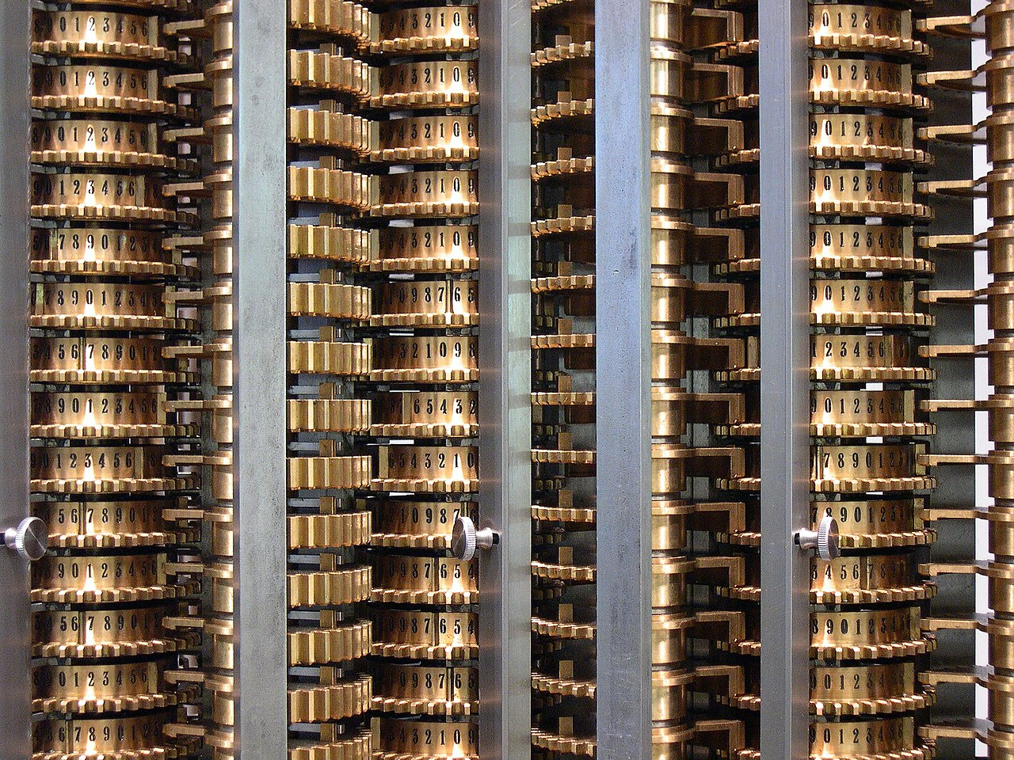
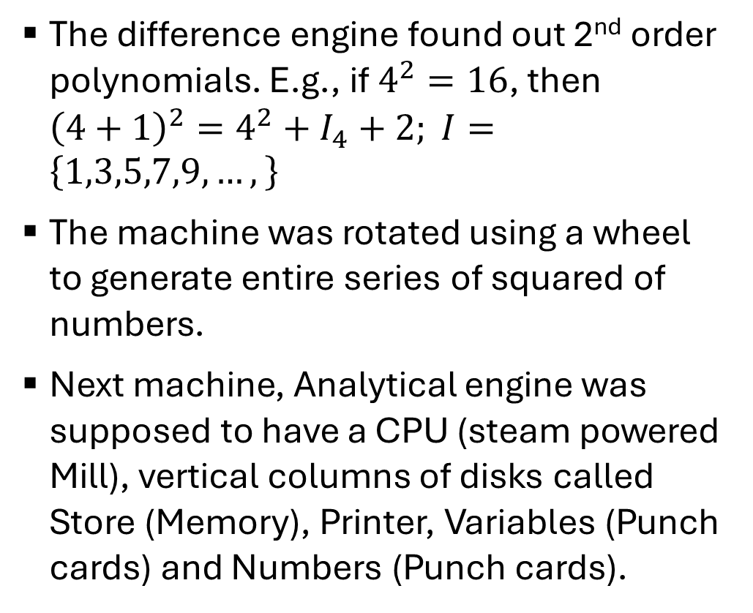
Sample 2
The Difference Engine
The difference engine found out 2nd order polynomials. E.g., if $4^{2}=16$, then ${\left(4+1\right)}^{2}=4^{2}+I_{4}+2; I=\left\{1,3,5,7,9,…,\right\}$
The machine was rotated using a wheel to generate entire series of squared of numbers.
Next machine, Analytical engine was supposed to have a CPU (steam powered Mill), vertical columns of disks called Store (Memory), Printer, Variables (Punch cards) and Numbers (Punch cards).

Slide 8
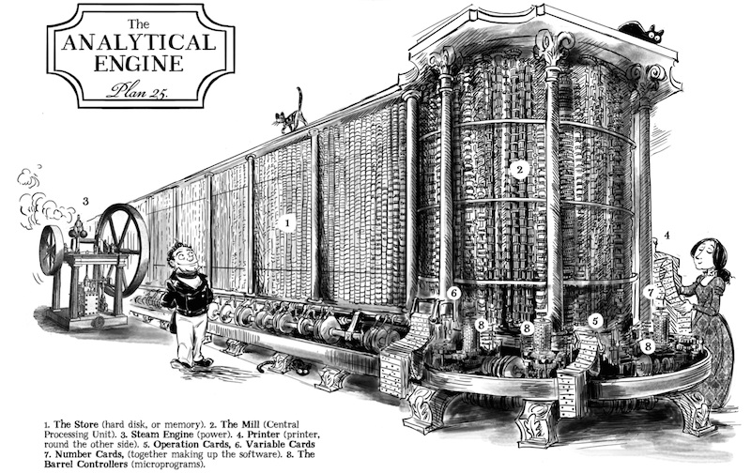
Sample 2

Slide 9
Sample 2
Analytical Engine
Ada Lovelace made several improvements to the design of this Analytical Engine. She proposed that for Analytical engine, code can be used instead of numbers.
The first contribution was the concept of Loops in this machine, i.e. the user should be able to repeat the same input multiple times.
Second contribution was providing a series of punch cards which will tell what portion of machine to run, i.e., pass a function.
This way, the analytical function could make virtually any calculation making use of Ada’s programs. Thus, making it Turing complete.
Notes:
A machine is Turing complete if it is can compute any problem which is computable using a Turing machine.

Slide 10
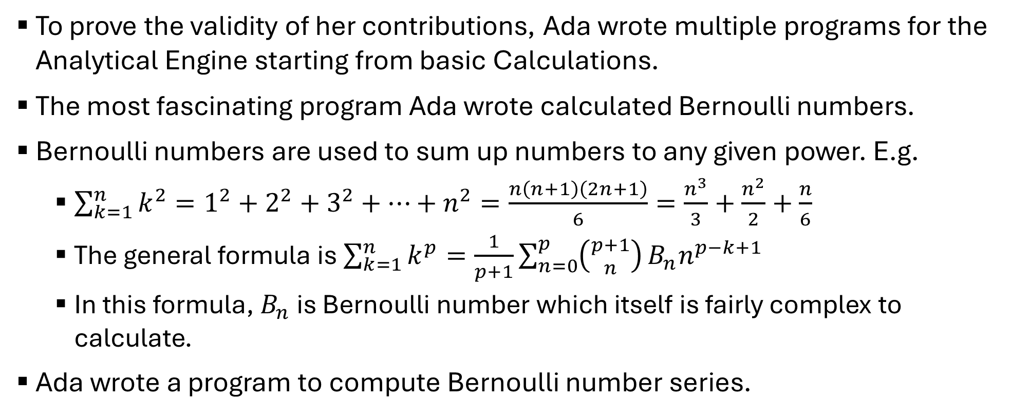
Sample 2
Note G – Calculating Bernoulli Numbers
To prove the validity of her contributions, Ada wrote multiple programs for the Analytical Engine starting from basic Calculations.
The most fascinating program Ada wrote calculated Bernoulli numbers.
Bernoulli numbers are used to sum up numbers to any given power. E.g.
$\sum_{k=1}^{n}{k^{2}}=1^{2}+2^{2}+3^{2}+…+n^{2}=\frac{n\left(n+1\right)\left(2n+1\right)}{6}=\frac{n^{3}}{3}+\frac{n^{2}}{2}+\frac{n}{6}$
The general formula is $\sum_{k=1}^{n}{k^{p}}=\frac{1}{p+1}\sum_{n=0}^{p}{\left({p+1 \atop n}\right)}B_{n}n^{p−k+1}$
In this formula, $B_{n}$ is Bernoulli number which itself is fairly complex to calculate.
Ada wrote a program to compute Bernoulli number series.

Slide 11
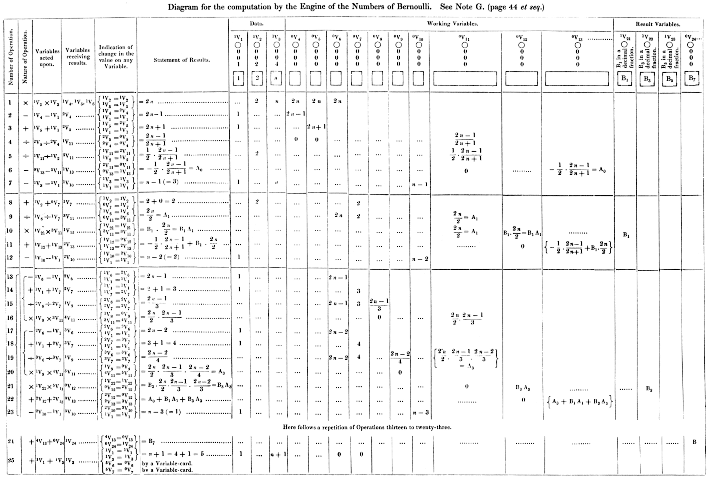

Sample 2

Slide 12
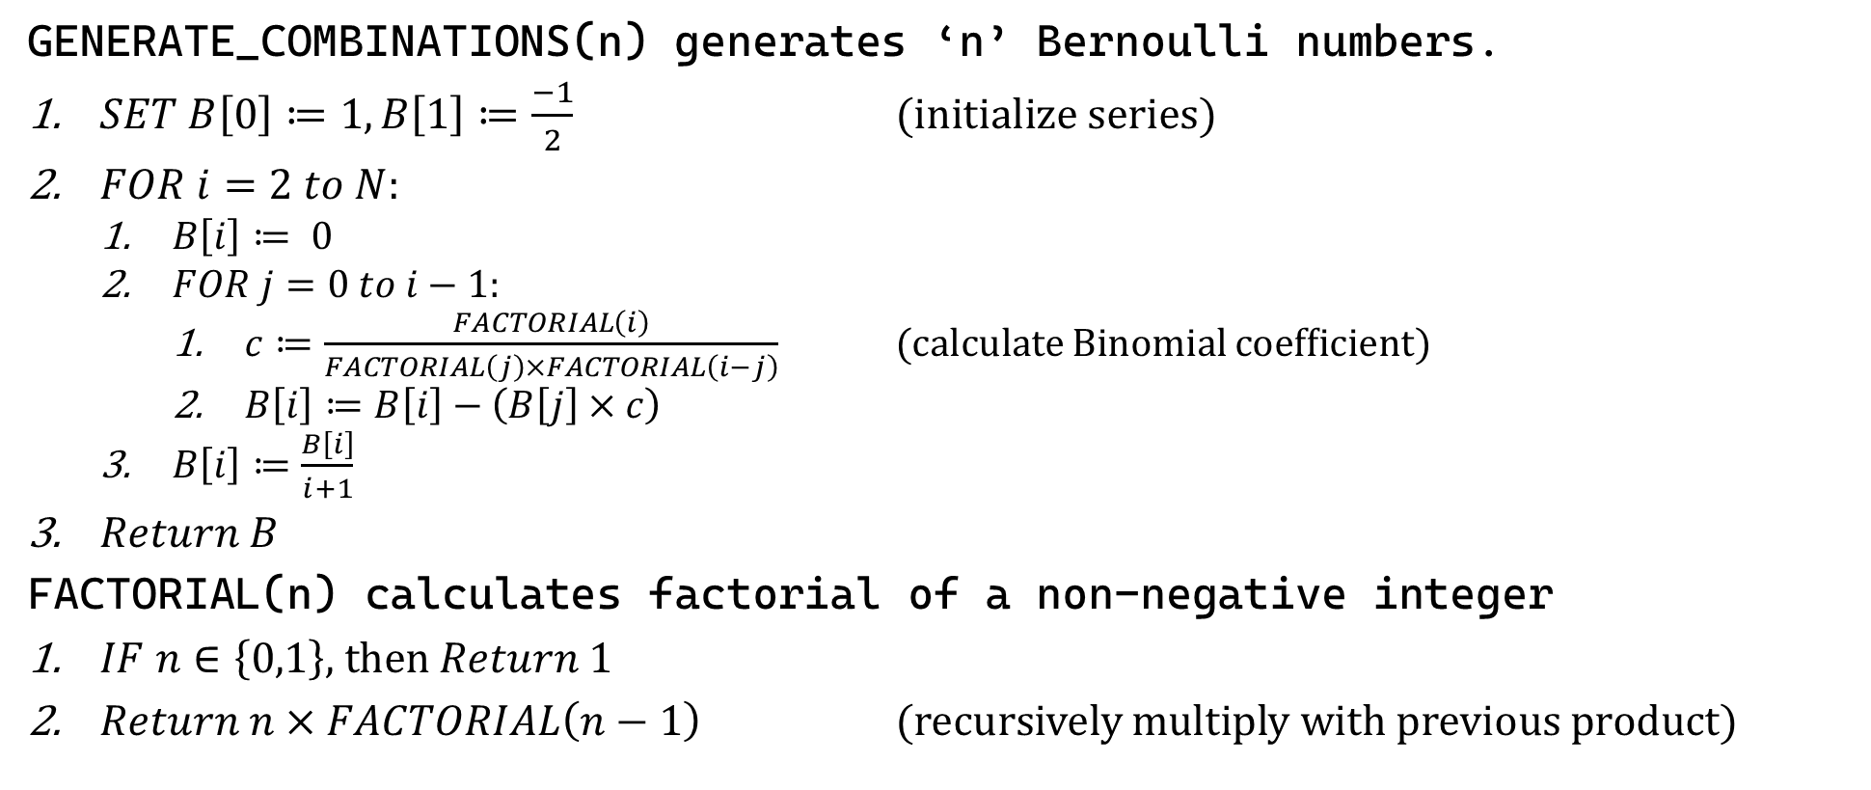
Sample 2
Note G – Calculating Bernoulli Numbers
GENERATE_COMBINATIONS(n) generates ‘n’ Bernoulli numbers.
$SET B\left[0\right]≔1,B\left[1\right]≔\frac{−1}{2}$ (initialize series)
$FOR i=2 to N$:
$B\left[i\right]≔ 0$
$FOR j=0 to i−1$:
$c≔\frac{FACTORIAL\left(i\right)}{FACTORIAL\left(j\right)×FACTORIAL\left(i−j\right)}$ (calculate Binomial coefficient)
$B\left[i\right]≔B\left[i\right]−\left(B\left[j\right]×c\right)$
$B\left[i\right]≔\frac{B\left[i\right]}{i+1}$
$Return B$
FACTORIAL(n) calculates factorial of a non-negative integer
$IF n∈\left\{0,1\right\}$, then $Return 1$
$Return n×FACTORIAL\left(n−1\right)$ (recursively multiply with previous product)

Slide 13
Sample 2
The Legacy
Ada Augusta Lovelace’s programs made her the first computer programmer. Note that these were not only algorithms, but code written specifically for Analytical engine.
Ada became countess of Lovelace; but she died at the age of 36 from cancer in 1852.
130 years after her death, the Analytical machine was finally invented and one of its copies is Computer History Museum in California, USA.
In 1936, Alan Turning proposed an Abstract machine based on deterministic finite automata called “Turing Machine” (now called computer). However, the Analytical Engine, after Ada’s enhancements was “Turning Complete” almost a century earlier.
Notes:
Recommended watch: https://www.youtube.com/watch?v=BlbQsKpq3Ak

Slide 14
Sample 2
Side note: Distinctions between Algorithm and Program
An algorithm:
Is independent of languages, hardware and software
Is conceptually designed
Requires domain knowledge
Is analyzed
Priori (analyze before building)
A Program:
Depends on language, hardware and software
Is implemented in a computer
Requires coding skills
Is tested
Posteriori (test after building)

Slide 15
Sample 2
DIY
Draw a circle.
Place two points to create a chord. Count the number of total segments.
Place 3rd point and connect it with the other two. Count again.
Place 4th point and connect all points with each other. Count again.
Place 5th point and repeat.
Can you guess the answer for 6 points? Verify by adding 6th point.
Design an algorithm (any language, any notations) which inputs number of distinct points to plot on a circle and calculates the number of segments formed when all points are connected.

Slide 16
QUESTIONS?

Slide 17



THANK YOU
Owais Hussain
+92 345-3174270
owaishussain@ieee.org
https://www.researchgate.net/profile/Owais-Hussain-3

